Slide 1

Mental Health Prediction Using Machine Learning
Group 2
Krishnaprasad V M
Rohit Pal
Manisha Mahor

Slide 2
INTRODUCTION
Technology is evolving round the clock in recent times. This has resulted in job opportunities for people all around the world. It comes with a hectic schedule that can be detrimental to people’s mental health. So During the Covid-19 pandemic, mental health has been one of the most prominent issues, with stress, loneliness, and depression all on the rise over the last year. Diagnosing mental health is difficult because people aren’t always willing to talk about their problems.
Machine learning is a branch of artificial intelligence that is mostly used nowadays. ML is becoming more capable for disease diagnosis and also provides a platform for doctors to analyze a large number of patient data and create personalized treatment according to the patient’s medical situation. In this article, we are going to predict the mental health of Employees using various machine learning models. We have collected the required data set from Kaggle.

Slide 3
The process is the following:
Library and data loading
Data cleaning
Encoding data
Covariance Matrix. Variability comparison between categories of variables
Data Visualisation
Scaling and fitting
Splitting the data set
Evaluating models
Logistic Regression
KNN Algorithm
Decision Tree Classifier
Random Forests
AdaBoost Classifier
Success method plot
Creating predictions on test set
Submission
Conclusions

Slide 4
Library and data loading
Imported several libraries for data analysis and machine learning tasks in Python.
Pandas is used for data manipulation and analysis.
NumPy is used for numerical computing and scientific computing.
Matplotlib and Seaborn are used for data visualization and plotting.
Scipy is used for scientific computing and statistical analysis.
Sklearn (Scikit-learn) is a machine learning library in Python, and it is used for data preparation, modeling, and validation.
The specific machine learning models included in this code are: Logistic Regression, Decision Tree Classifier, Random Forest Classifier, Extra Trees Classifier, MLP Classifier, K-Nearest Neighbors Classifier, AdaBoost Classifier, and Gaussian Naive Bayes.

Slide 5
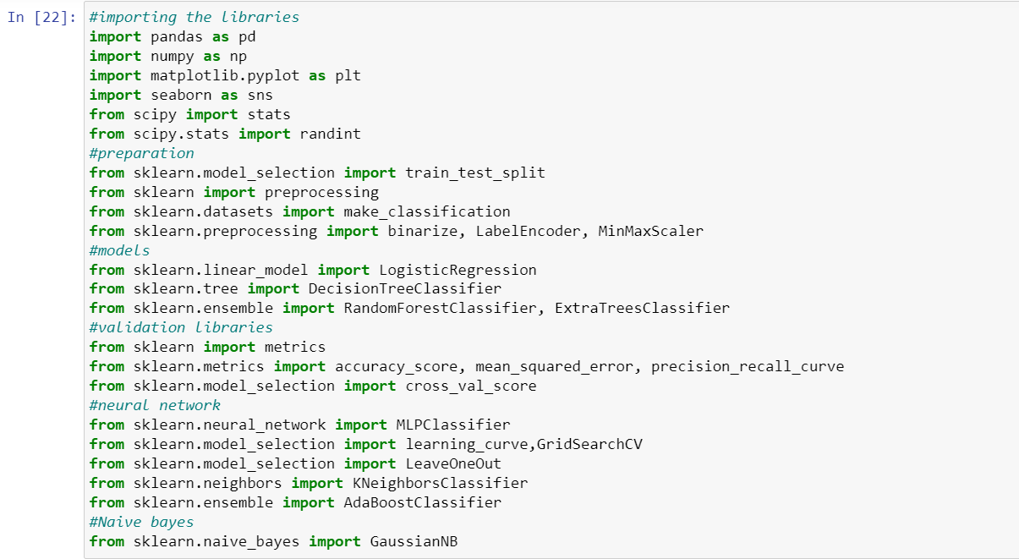

Slide 6
Data Cleaning
Data cleaning is a crucial step in data analysis, and Pandas is a popular Python library that offers powerful tools for data cleaning. Here are some common data cleaning tasks that we are used in our project.
Removing unnecessary columns: Use the drop() method to remove unnecessary columns, or use indexing to select the desired columns.
Handling missing values:Use the fillna() method to fill missing values with a specified value or method.
Handling string data: Use string methods such as str.replace() to clean information from string data.

Slide 7
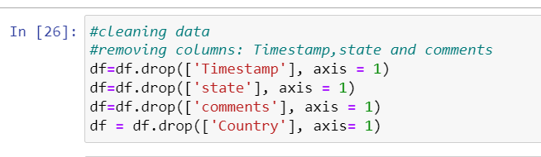
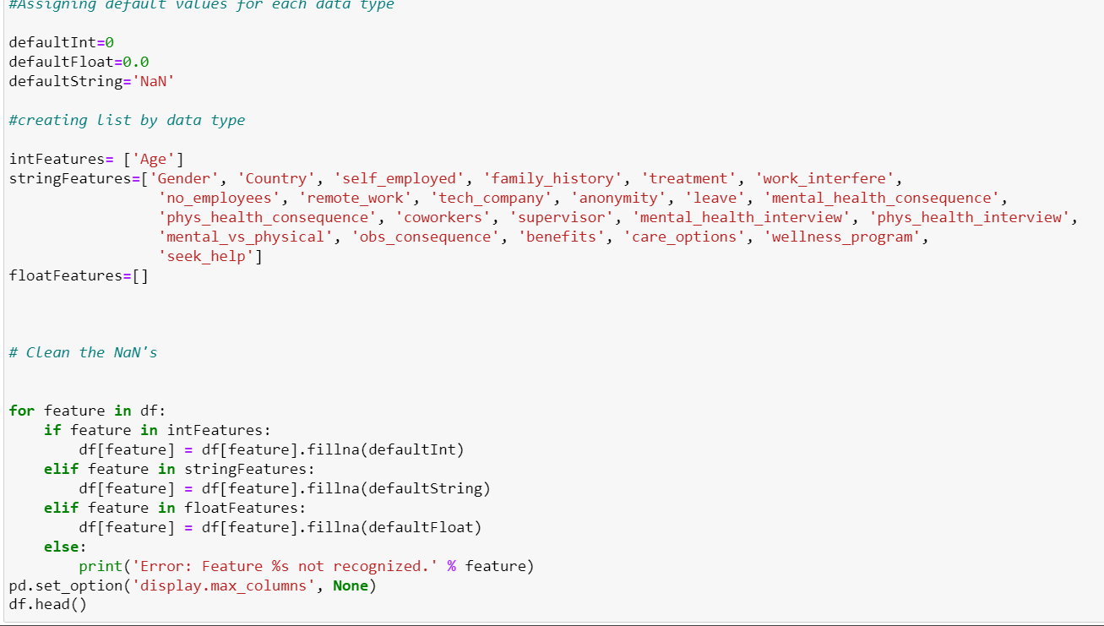

Slide 8
Encoding data
Encoding is a technique used to convert categorical data into numerical data. It is useful when working with machine learning algorithms that can only handle numerical data. LabelEncoder() function in scikit-learn is a convenient way to perform label encoding in Python.
So, in this project we were used Label Encoder function for converting the categorical data into numerical data.

Slide 9
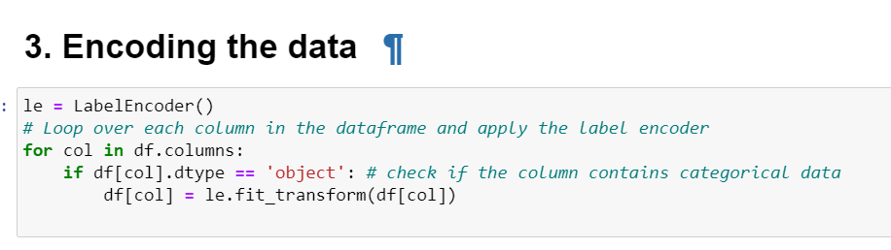

Slide 10
Covariance Matrix. Variability comparison between categories of variables
A covariance matrix is a square matrix that shows the covariances between two or more variables. A covariance matrix is useful for examining the relationships between multiple variables. It can be used to compare the variability between different categories of variables.

Slide 11
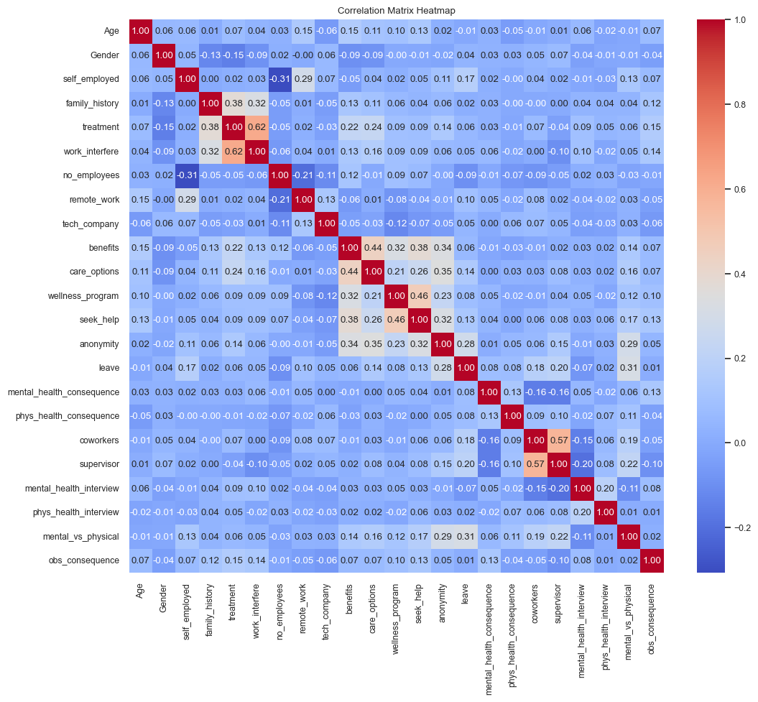

Slide 12
Data Visualisation
The resulting plot shows the distribution of ages in the dataset as a histogram with a density curve overlaid on top. The histogram shows the frequency of ages in each bin, while the density curve shows the probability density function of the ages. This plot can be used to gain insights into the age distribution of the dataset, such as identifying any peaks or clusters in the distribution, or whether the distribution is skewed or symmetrical.

Slide 13
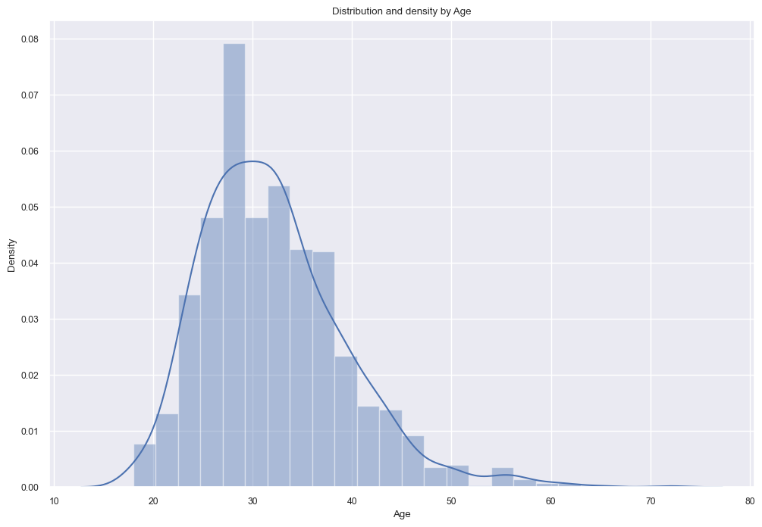

Slide 14
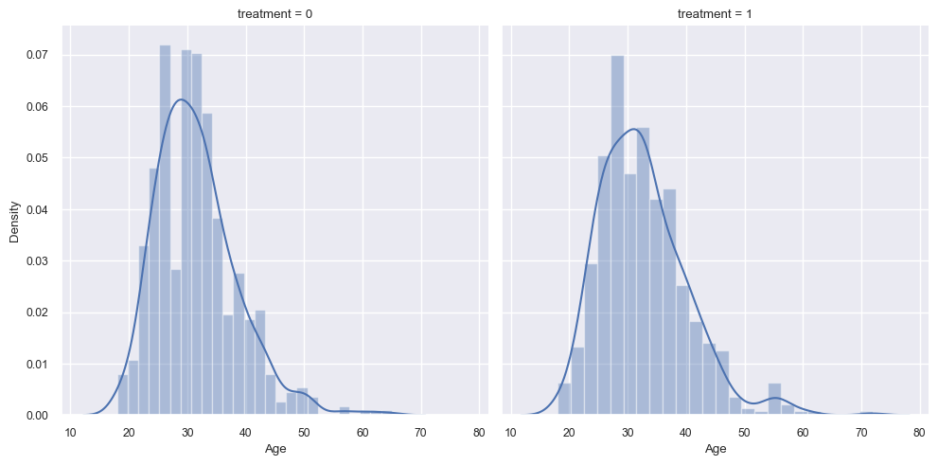

Slide 15
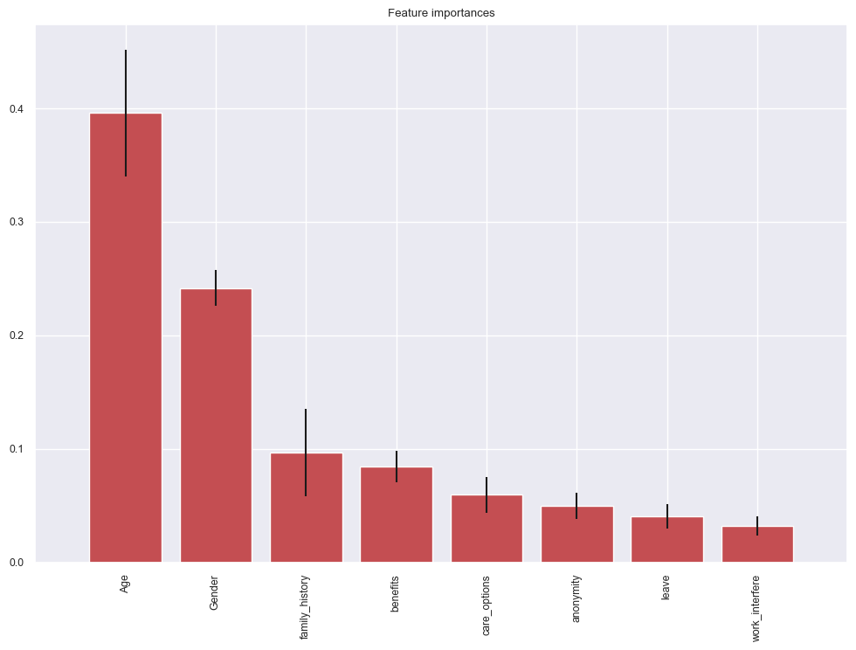

Slide 16
Scaling and fitting
Scaling:
Many machine learning models require that input features be on the same scale. If the features are on different scales, then some features may dominate others in terms of their influence on the model. Scaling ensures that all features have the same scale and therefore the same influence on the model.
Scaling also helps to avoid numerical instabilities that can occur when features are on vastly different scales, which can negatively impact the model's accuracy.
Fitting:
Fitting is the process of calculating the optimal parameters of a model so that it can accurately predict unseen data. For example, in the case of the MinMaxScaler used in the code you provided, fitting is the process of calculating the minimum and maximum values of the 'Age' column so that it can be scaled properly.
In many machine learning models, the process of fitting involves training the model on a subset of the data and then evaluating its performance on a separate validation set. This helps to ensure that the model is not overfitting to the training data (i.e., memorizing the training data instead of learning to generalize to new data).

Slide 17
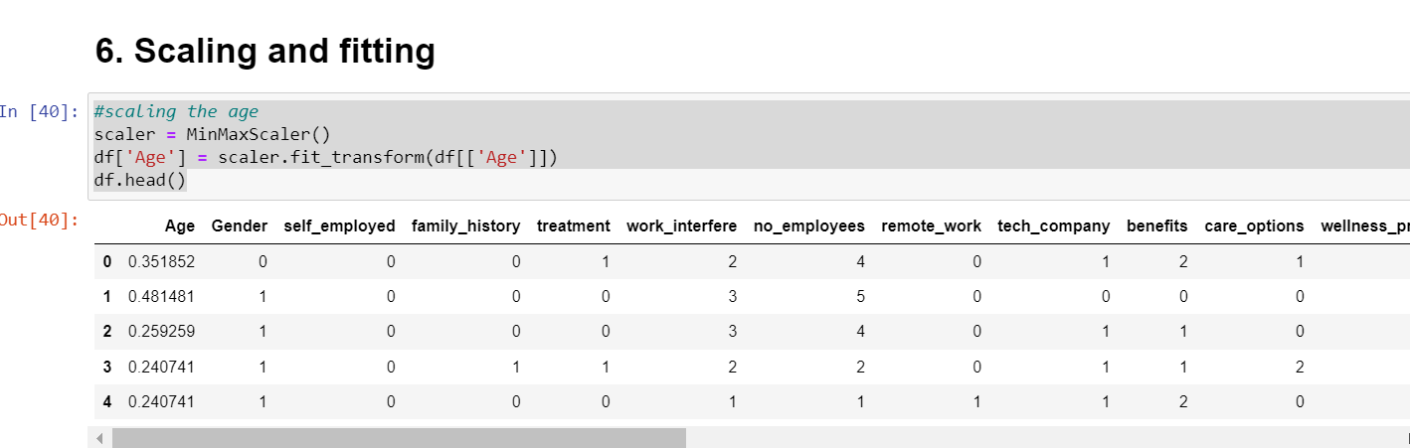

Slide 18
Splitting the data set
Splitting the dataset is an important step in machine learning, as it helps to evaluate the performance of the model on unseen data. Here's why:
In machine learning, it is important to evaluate the performance of a model on data that it has not seen before. This helps to ensure that the model is not simply memorizing the training data and can generalize well to new, unseen data.
Splitting the dataset into training and testing sets allows us to train the model on one set of data (the training set) and evaluate its performance on another set of data (the testing set). This helps to provide an estimate of how well the model will perform on unseen data in the real world.
In some cases, such as when the dataset is small, it may be useful to use techniques such as cross-validation to split the dataset into multiple training and testing sets. This can help to improve the robustness of the model's performance estimates.

Slide 19
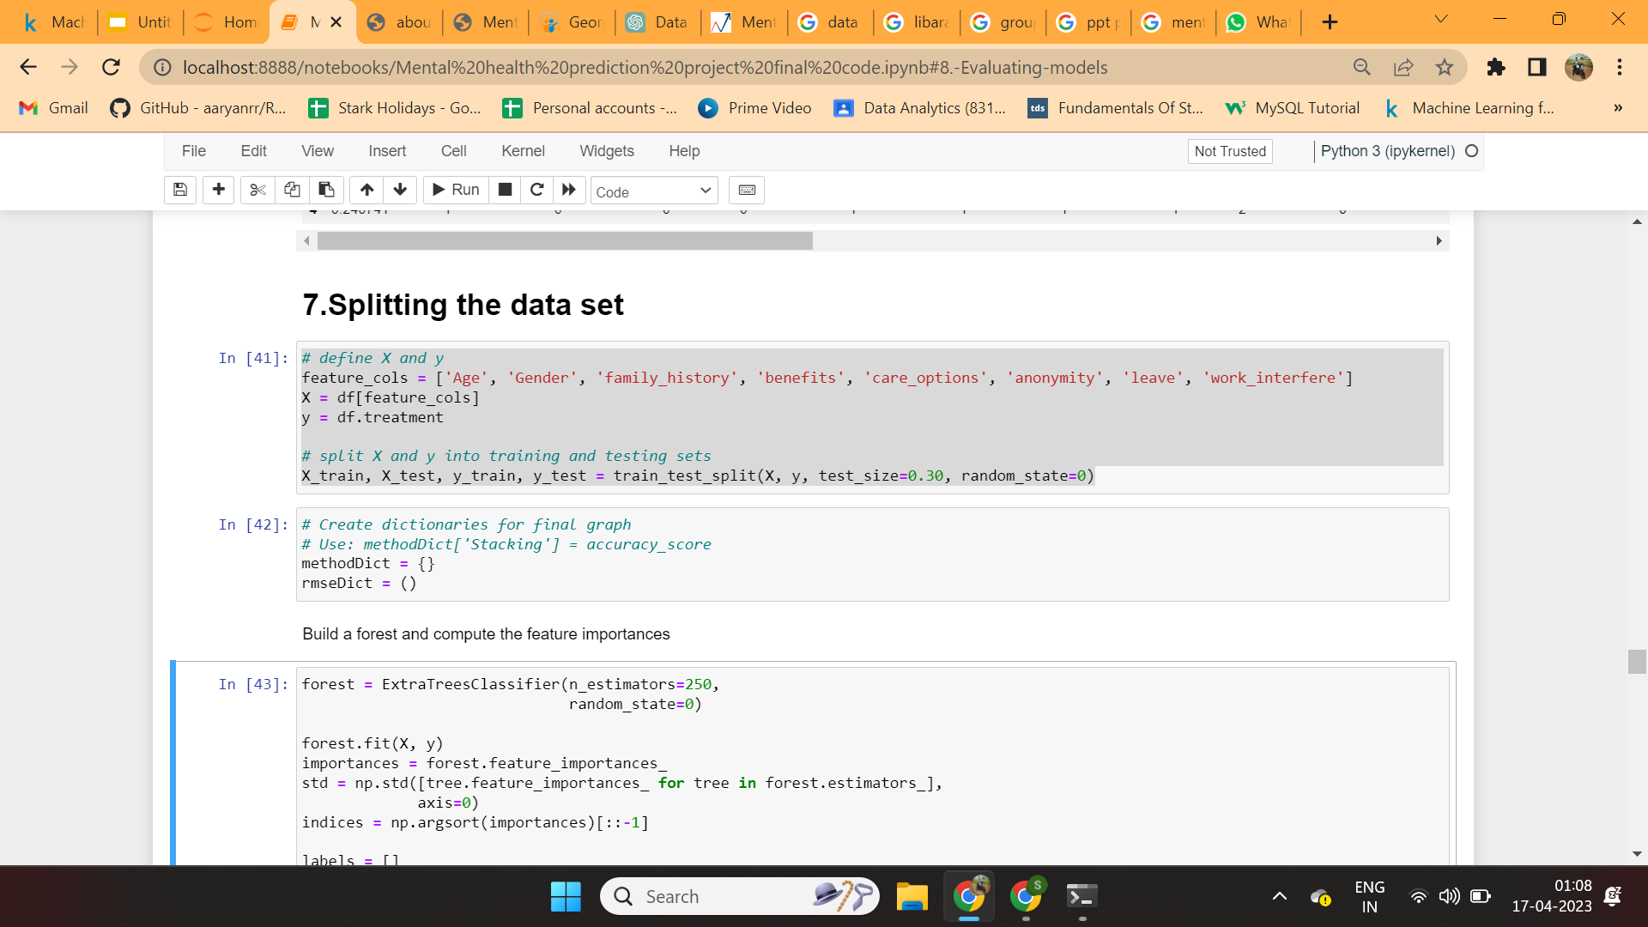

Slide 20
Evaluating models
Logistic Regression: Logistic regression is a statistical method used for binary classification problems, where the goal is to predict a binary outcome (0 or 1) based on a set of input variables or features.
Accuracy of data set by using logistic regression
“Accuracy: 0.7962962962962963”“

Slide 21
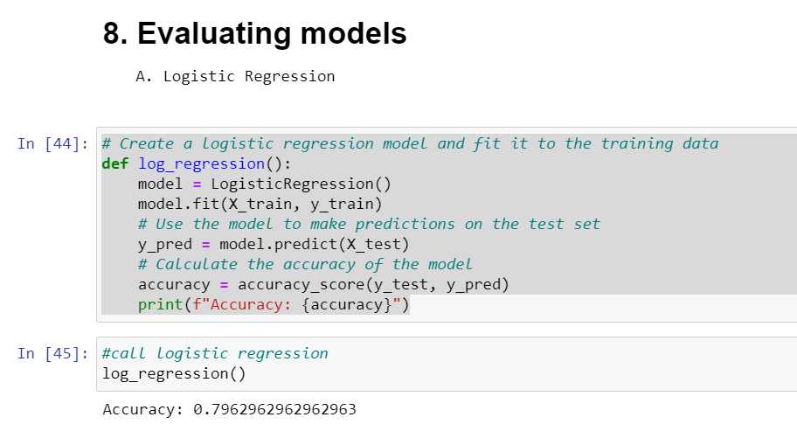

Slide 22
K-Nearest Neighbors (KNN) algorithm: It is a non-parametric and lazy learning algorithm used for both classification and regression problems. It is a type of instance-based learning where the algorithm predicts the class of a new data point based on the classes of its k nearest neighbors in the training dataset.
“Accuracy: 0.8068783068783069”

Slide 23
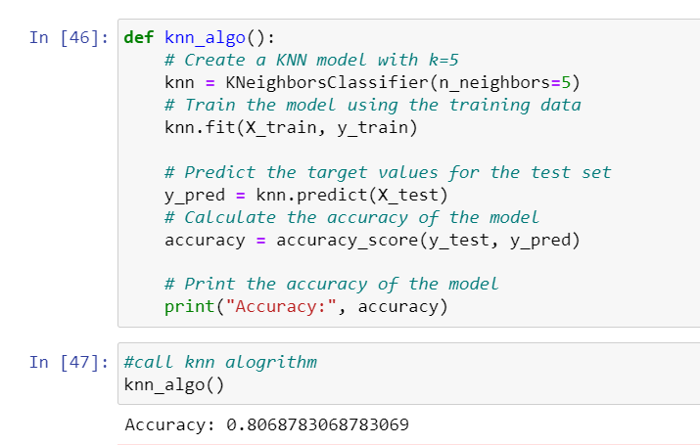

Slide 24
Decision Tree Classifier: It is a supervised machine learning algorithm that is used for classification problems. It is a tree-based model that recursively splits the data into subsets based on the most significant features, resulting in a tree-like structure. The goal is to create a model that can predict the target variable by learning simple decision rules derived from the data features.
Accuracy: 0.7513227513227513

Slide 25
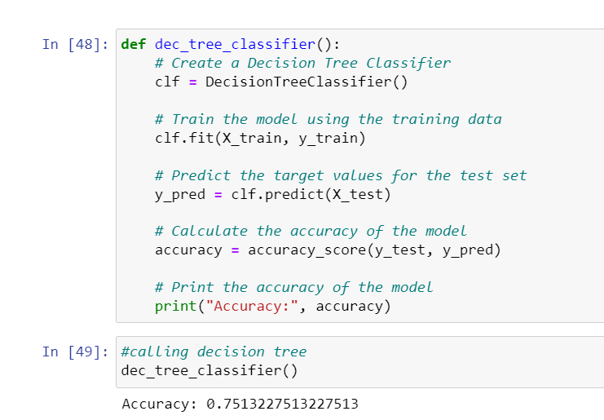

Slide 26
Random forest Classifier: It is an ensemble learning method for classification, regression and other tasks. In random forest, a large number of decision trees are created, and each tree is trained on a random subset of the training data. The output of the random forest is the majority vote of the decision trees. It reduces overfitting and improves the accuracy of the model.
Accuracy: 0.7962962962962963

Slide 27
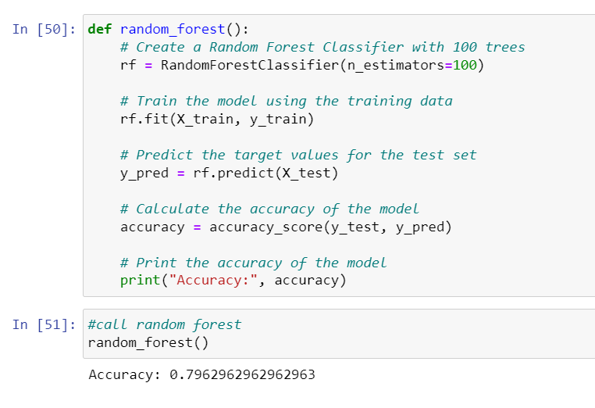

Slide 28
AdaBoost Classifier: It is an ensemble learning method that can improve the classification accuracy of weak learners (classifiers that perform only slightly better than random guessing) by combining their predictions. AdaBoost works by iteratively training a sequence of weak learners, where each subsequent learner is trained on the examples that were misclassified by the previous learner. The final prediction is a weighted sum of the predictions made by each learner.
Accuracy: 0.8201058201058201
“Best prediction”

Slide 29
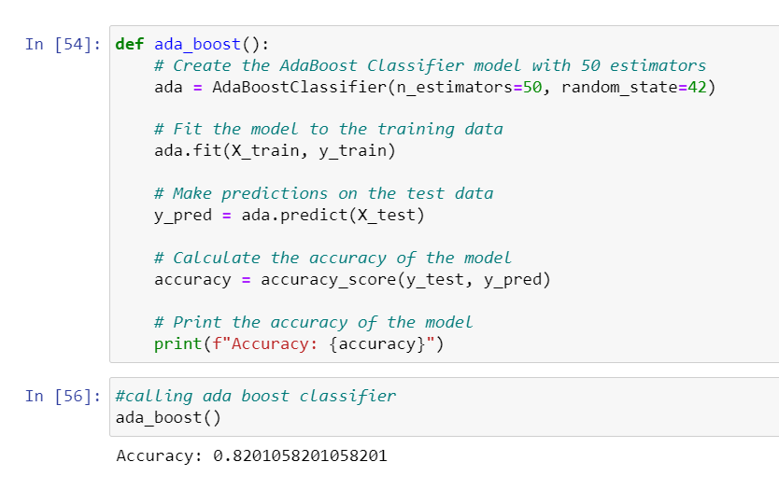

Slide 30
Creating Prediction on test data set using AdaBoost Classifier
We have predicted the test results of given data by using the best method “Ada Boost Classifier”
The resultant data is then stored on another csv file, name: “submission”
The final prediction consists of 0 and 1. 0 means the person is not needed any mental health treatment and 1 means the person is needed mental health treatment.

Slide 31
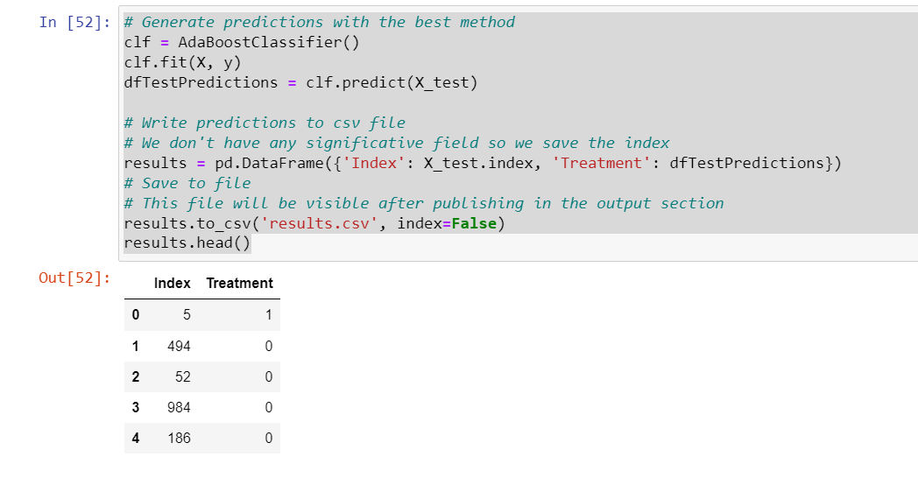

Slide 32
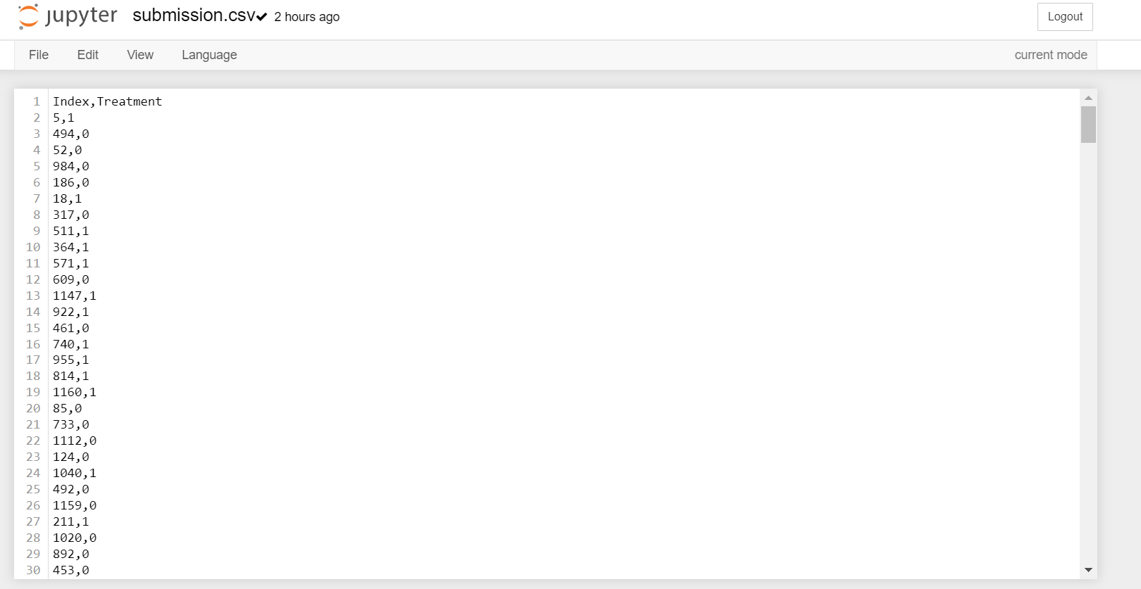

Slide 33
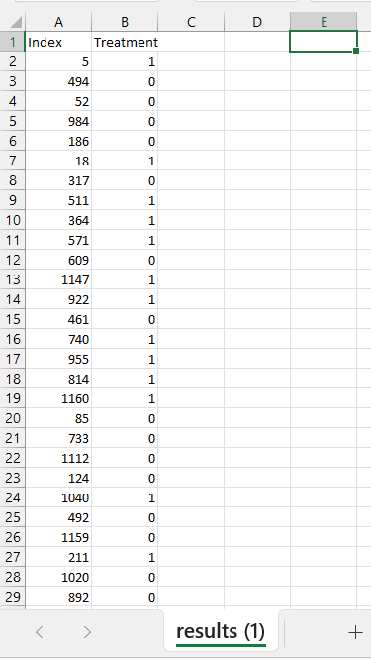

Slide 34
Conclusions
After using all these Employee records, we are able to build various machine learning models. From all the models, ADA–Boost achieved 82% accuracy along with that we were able to draw some insights from the data via data analysis and visualization.

Slide 35


